Slide 1
Insurance Fraud Detection using Blockchain and ML
Project Review 1

Slide 2
Group 4
Arul Arasu N (Roll No: 20Z306)
Dhanaseelan V (Roll No: 20Z313)
Dinesh Baabu R (Roll No: 20Z315)
Lokajit G (Roll No: 20Z328)
Sudarshan S (Roll No: 20Z350)

Slide 3
Problem Statement
In the insurance industry, the rise of fraudulent activities has become a significant concern, leading to financial losses for both insurers and legitimate policyholders. The main objective of this project is to develop an advanced system that utilizes a Machine Learning algorithm to effectively detect fake insurance claims while ensuring the secure storage of genuine transactions in a blockchain.

Slide 4
Literature Review
A novel fraud detection and prevention method for healthcare claim processing using machine learning
Serious problem causing economic losses to insurance and government.
Machine learning and blockchain technology integration
Decision tree classification algorithms for analysis
Reducing administrative costs and improving healthcare coverage
Challenges in real-world healthcare settings
Data privacy and security concerns
Resistance from healthcare providers and insurers

Slide 5
Literature Review
Insurance Fraud Detection Using Novel Machine Learning Technique
Limitations of traditional fraud detection techniques
Proposal of a novel approach using eRFSVM hybrid classifier
Combination of Random Forest and Support Vector Machine algorithms
Exceptional accuracy of 97.176% in evaluating customer claims
Challenges of the proposed approach:
1.Data volume
2.New fraud types

Slide 6
Literature Review
ClaimChain: Secure Blockchain Platform for Handling Insurance Claims Processing
Introduction of ClaimChain as a secure blockchain platform
Integration of machine learning and NICB-identified red flags in fraud prevention
Detailed dataset analysis on ClaimChain testbed revealing patterns in fraudulent claims
Emphasis on potential benefits for the insurance industry
ClaimChain code is currently intended for research purposes only and may not be suitable for use in real-world systems.

Slide 7
Literature Review
“Detecting insurance claims fraud using machine learning techniques”
Takeaways
Set of rules and anomalies for creating raw data
Compare performance using Confusion matrix
Random forests and Decision Tree outperformed Naive Bayes

Slide 8
Literature Review
“Fraud Detection and Analysis for Insurance Claims using Machine Learning”
Takeaways
Large amount of dataset
Supervised and Unsupervised Algorithms
ML models vs. Traditional methods
Data privacy concerns and model maintenance

Slide 9
Literature Review
“Blockchain technology of fraud Detection and Risk Prevention in Insurance Industry”
Takeaway:
Customer and Customer participant for registering insurance creating new block in blockchain network
Validation process for insurance claim and submission claim
Results received to via smartphone or PC.

Slide 10
Literature Review
“Avoiding Insurance Fraud : A Blockchain-based Solution for the Vehicle Sector”
Takeaways :
Implementing S/W tools such as Truffle Framework, Solidity, Metamask, Ganache and Node.js.
Framework to implement the blockchain network.

Slide 11
System Requirements
Software Requirements
Blockchain Platform: Choose a suitable blockchain platform for implementing your system. Eg: Ethereum
Smart Contracts: Develop smart contracts that handle the validation of insurance claims and their addition to the blockchain. These contracts should include logic for verifying claim details and authenticity.
Machine Learning Models: Integrate machine learning models for fraud detection. These models can analyze historical data to identify patterns of fraudulent claims.

Slide 12
Hardware Requirements
Security Measures: Implement hardware security modules (HSMs) to enhance the security of private keys and cryptographic operations.
Data Storage: Set up storage solutions for storing blockchain data, historical data, and backups.
Networking: Ensure a reliable and fast internet connection to support the communication between nodes and users

Slide 13
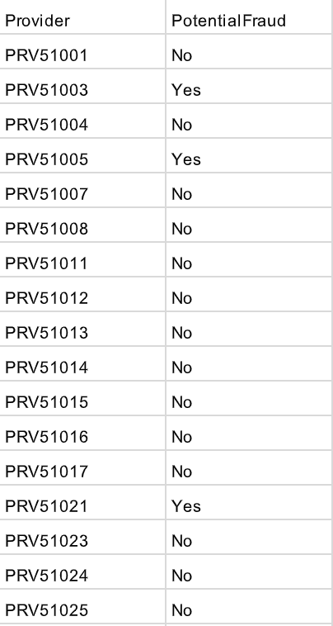
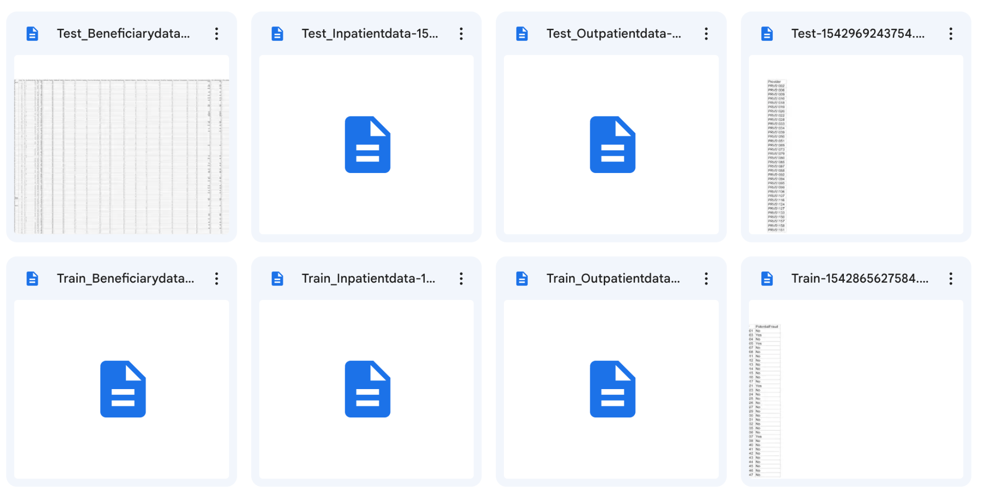
Datasets

Slide 14
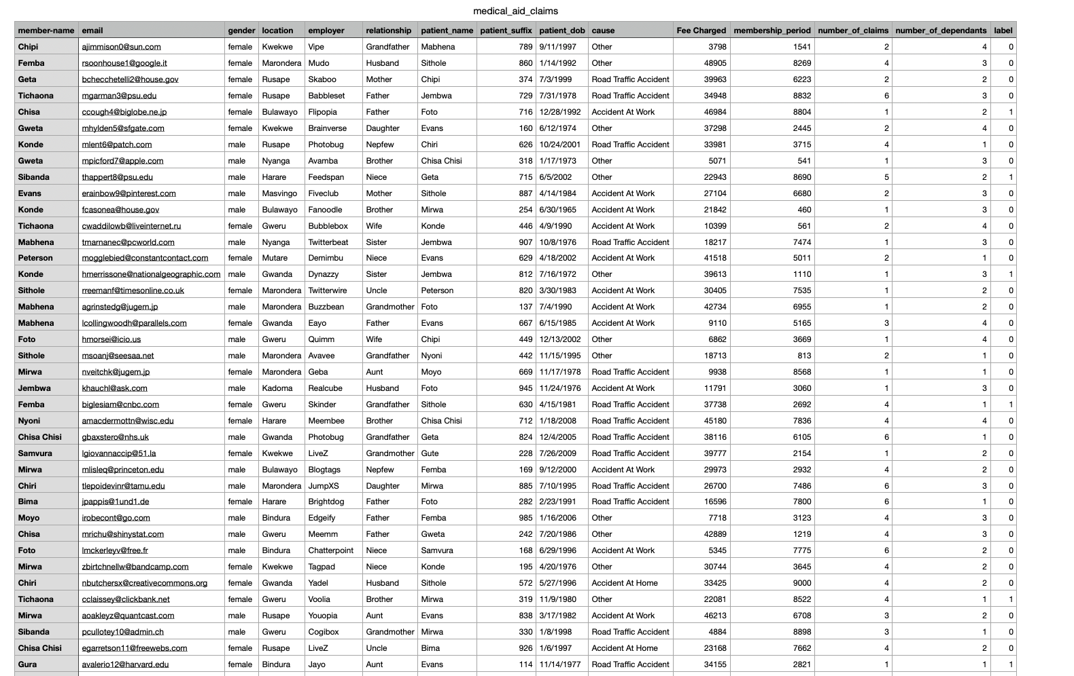

Slide 15
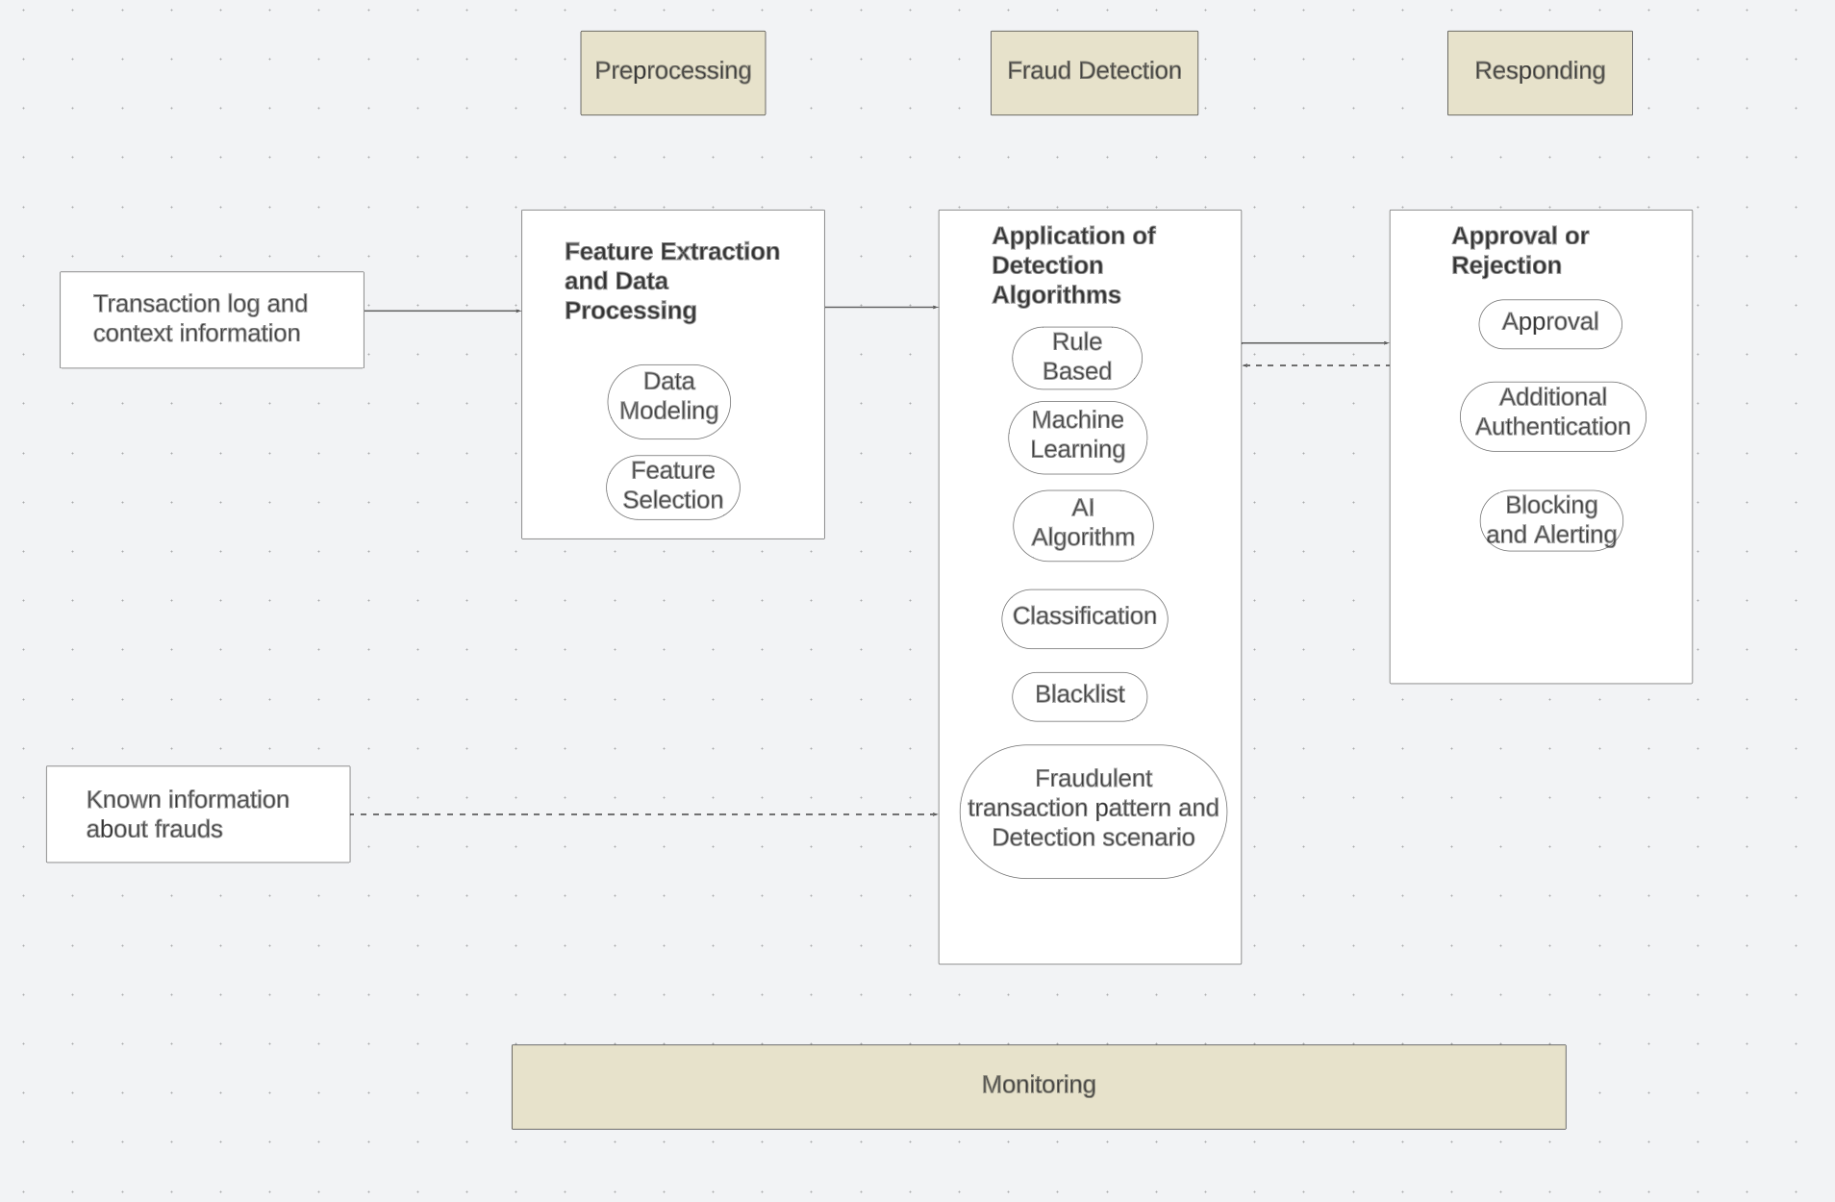
System Architecture

Slide 16


